Slide 1


Strongest ETL tool on the market

Slide 2

CONTENTS
1. Map Reduce and RDD why Spark was created
2. What is Spark and what is it used for
3. What libraries Spark has.
4. A story about each library separately
5. To tell about RDD, DataFrames, DataSets
6. RDD vs DataFrames vs DataSets
7. What types of data can be stored in them
8. Spark Dstream
9. Spark Structure Streaming
10. What's the difference between it? Spark Dstream vs Spark Structure Streaming
11. Spark SQL and Pandas code examples, how to work with it

Slide 3
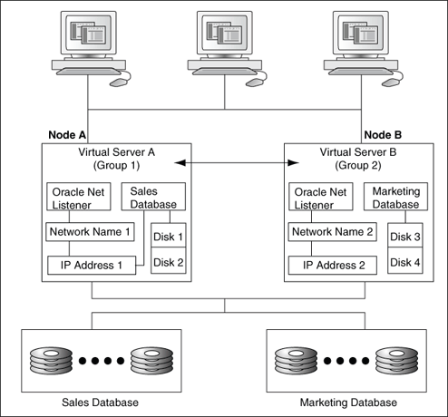
Custer and Node
Nodes represent physical or virtual machines that provide CPU and RAM resources for container-based applications. Nodes are grouped together into clusters.

Slide 4

Map Reduce and why Spark was created
MapReduce is a Hadoop framework used for writing applications that can process vast amounts of data on large clusters.
In 2005 builded a distributed computing infrastructure for a Java-based free software search engine. Its basis was a publication of Google employees.
Major companies in the market have worked with him. In February 2008, Yahoo launched a clustered search engine based on 10,000 processor cores operated by Hadoop

Slide 5

Problems, The Big Problems…
Each calculation is saved to the hard disk. This delays the execution of the program
Difficult code architecture. At the end of it comes out a very long code
1
3
2
You can only write code in Java
4
Your face when you wrote the code for Map Reduce:

Slide 6
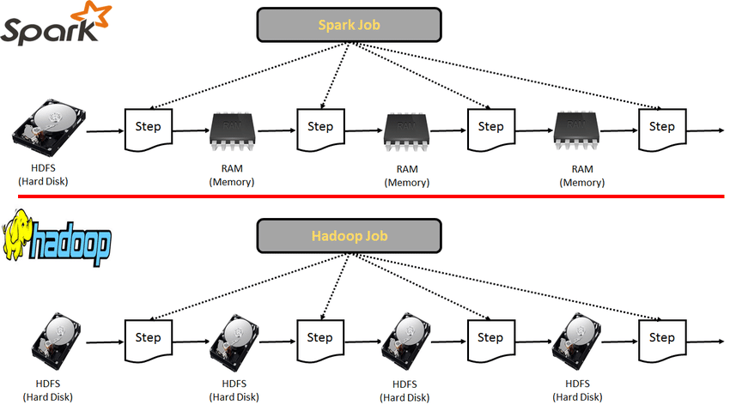
Each calculation is saved to the hard Disk
Every operation it saves to HDFS. In HDFS, files are stored in folders as in a file system, so in order to save the information in HDFS it needs to convert it into the correct format

Slide 7
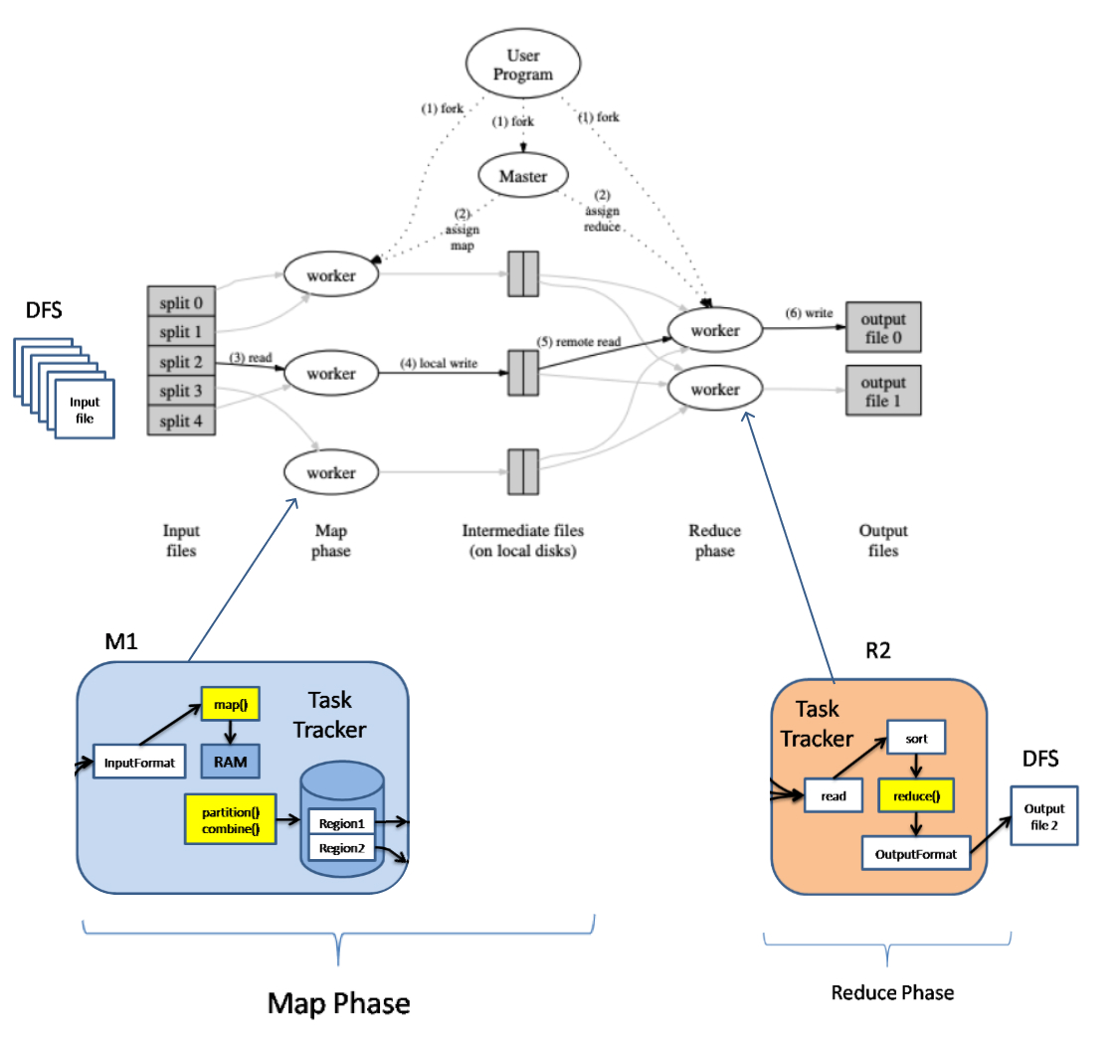

Slide 8
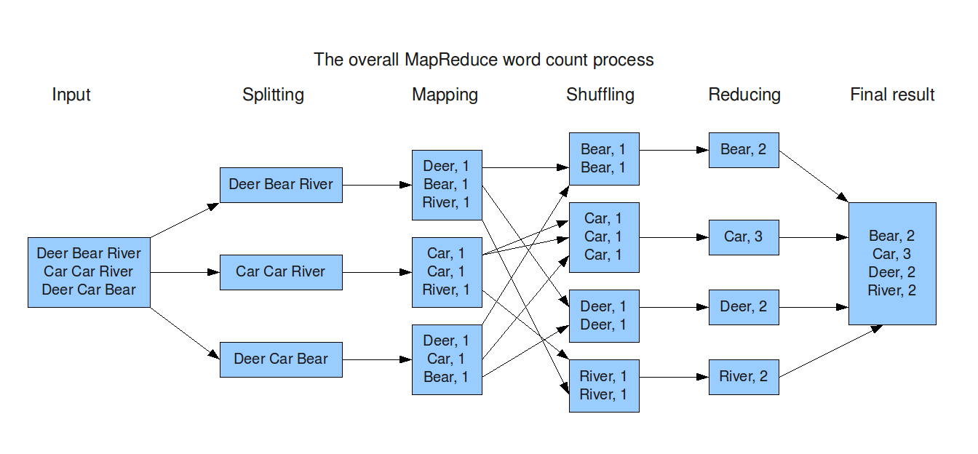
Map Reduce example, word count
In MapReduce word count example, we find out the frequency of each word. Here, the role of Mapper is to map the keys to the existing values and the role of Reducer is to aggregate the keys of common values. So, everything is represented in the form of Key-value pair

Slide 9
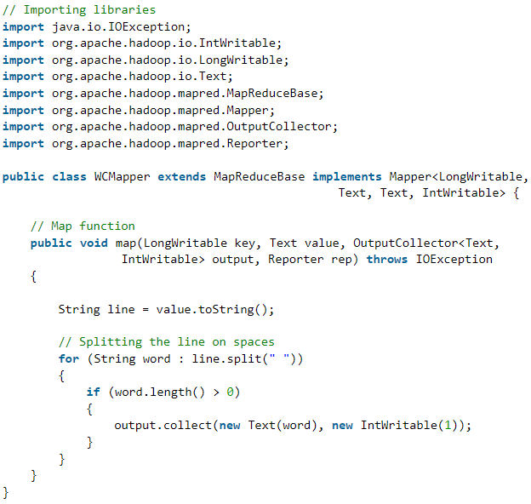
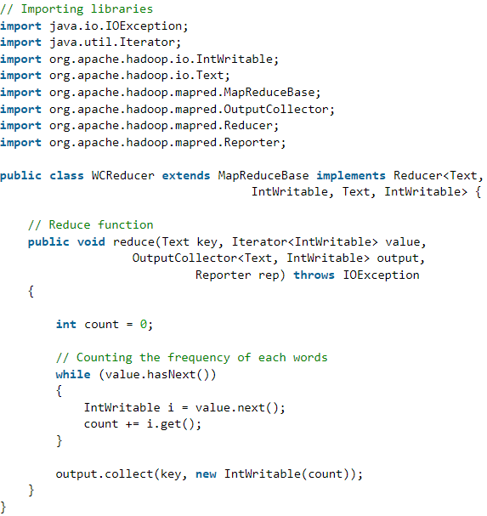
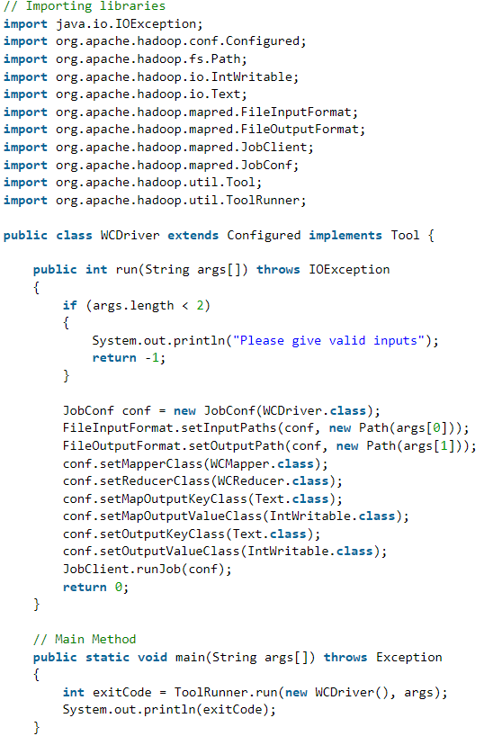
You need a lot of time for programming

Slide 10

How I would like to see the code
get File.txt
read.File.txt
split.File
map(splited.File)
suffle(maped.File))
reduce(suffled.File)
give.output

Slide 11

What is Spark and what is it used for

Slide 12
Smart problem solving
The Spark project was launched by Matei Zaharia AMPLab of Berkeley University in 2009, and its code became open in 2010 under the BSD license.

Slide 13
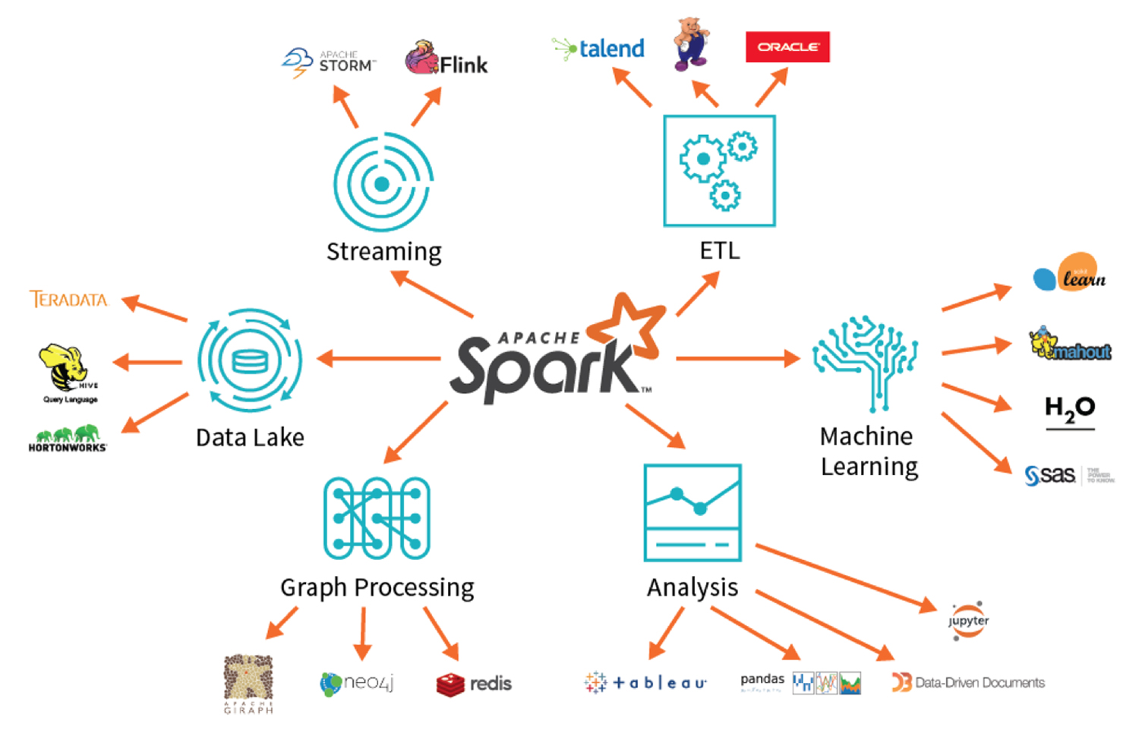
Apache Spark was created, smart problem solving
Allows you to write code in different languages (Python)
Very short code
Good optimization (100 times faster than MapReduce), many additional libraries

Slide 14
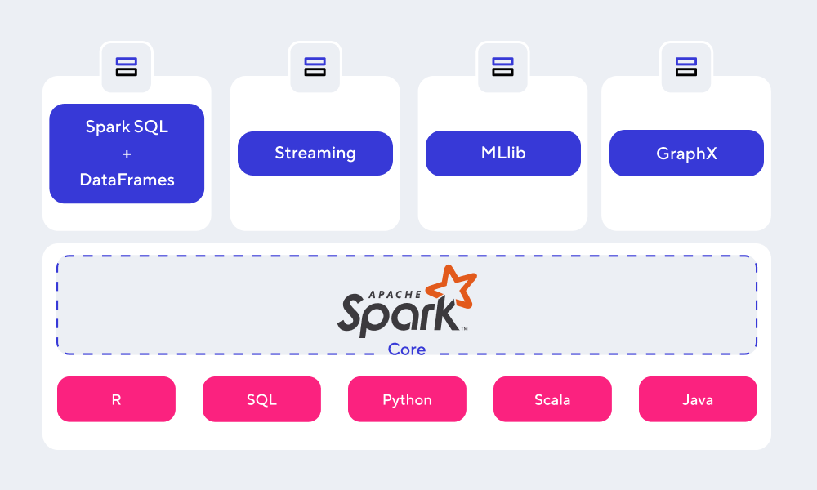
Spark Ecosystem, what libraries Spark has

Slide 15
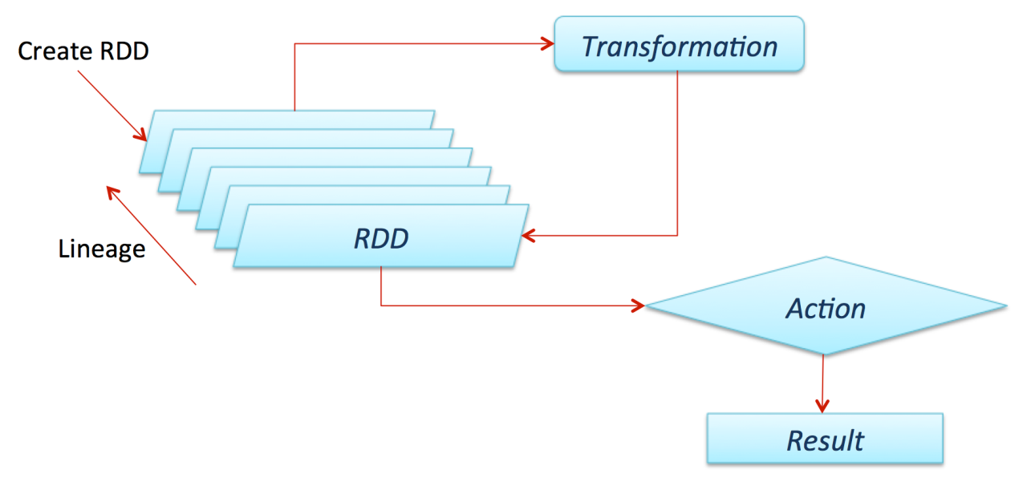
Spark RDD
resilient distributed dataset
is a simple, immutable, distributed collection of objects in the Apache Spark framework. RDD is a distributed dataset that is divided into many parts that are processed by different nodes in the cluster.
RDDs are fault-tolerant because they monitor data flow to automatically recover lost data in the event of failure
Distribute collection of JVM model
Not modifiable
Available in different programming languages (Python)

Slide 16
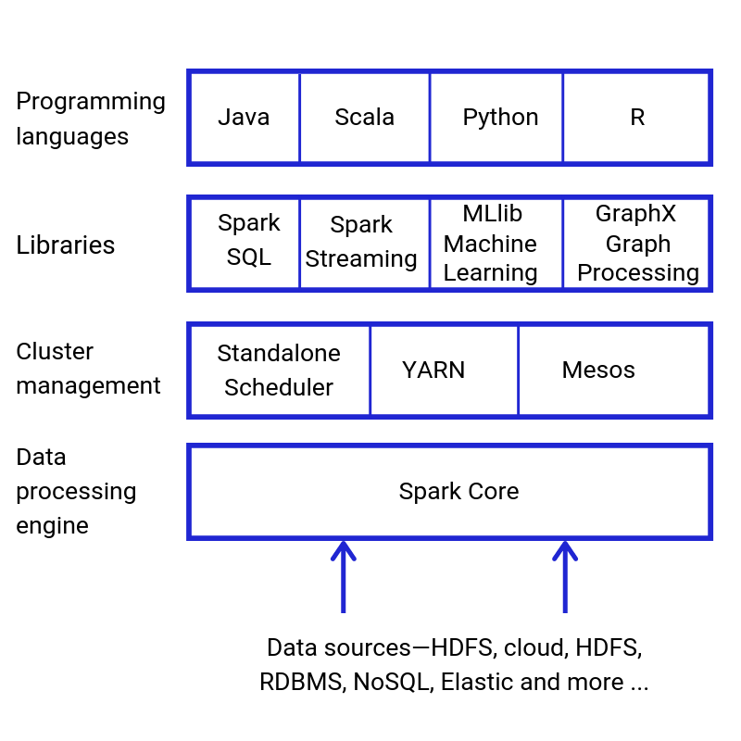
Spark Core
Connected to Data sources
Does all processing with RDD
Do cluster management
Connecting to spark UI
Support API of programming languages
Spark core:
It is the underlying processing engine that underpins the entire platform. The kernel interacts with storage systems, manages memory, schedules and distributes the load in the cluster. It is also responsible for API support of programming languages.

Slide 17
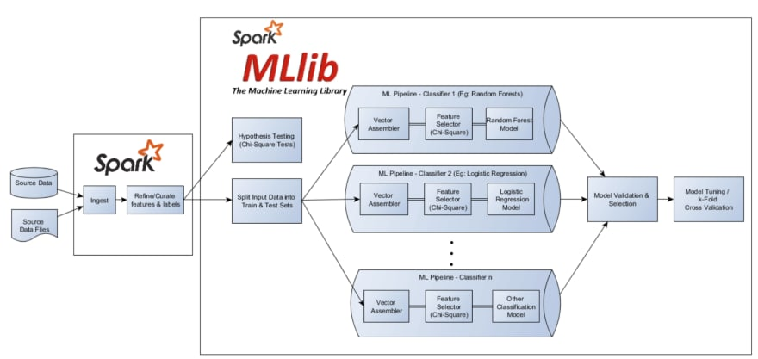
Spark ML Lib
Library that helps in managing and simplifying many of the machine learning models for building tasks, such as featurization, pipeline for constructing, evaluating and tuning of the model.
Spark core:
ML Algorithms
Featurization
Pipelines
Model Tuning
Persistence

Slide 18
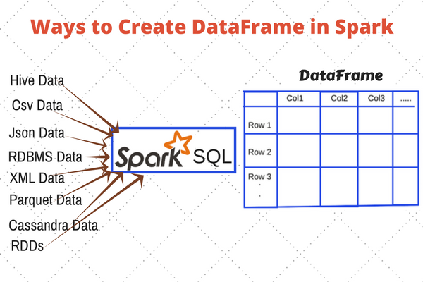
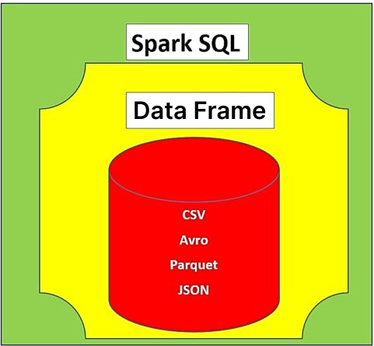
Spark Data Frame
DataFrame is a distributed collection of data organized into named columns. It is conceptually equivalent to a table in a relational database or a data frame in R/Python, but with richer optimizations under the hood. DataFrames can be constructed from a wide array of sources such as: structured data files, tables in Hive, external databases, or existing RDDs.

Slide 19
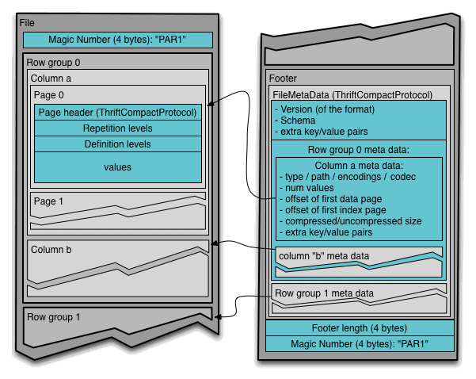

Parquet File Format
A binary, column-oriented big data storage format originally created for the Hadoop ecosystem, allowing you to take advantage of the compressed and efficient column-oriented presentation of information

Slide 20
Spark Data Structures
RDD
Data Frame
Data Set
Immutable | Yes | Yes | Yes
Schema | No | Yes | Yes
Optimizer engine | No | Catalyst | Catalyst
Language Support | Python, Java, Scala, R | Python, Java, Scala, R | Java, Scala
Level | Low | High (build on RDD) | High (DataFrame extension)
Date | 2011 (Spark 1.0) | 2013 (Spark 1.3) | 2015 (Spark 1.6)
Memory Use | High | Medium | Low (Tungsten Optim.)
SQL query | No | Yes | Yes

Slide 21
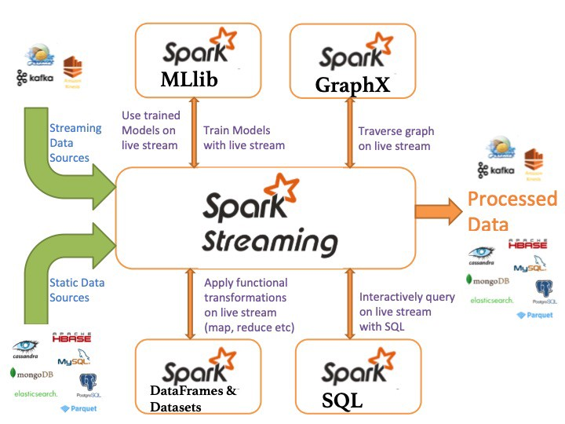
Spark Streaming
Spark Streaming is an extension of the core Spark API that enables scalable, high-throughput, fault-tolerant stream processing of live data streams

Slide 22

Spark Structure Streaming
Spark Structure Streaming
Spark DStream
Structured Streaming is a scalable and fault-tolerant stream processing engine built on the Spark SQL engine. You can use the Dataset/DataFrame API in Scala, Java, Python or R to express streaming aggregations, event-time windows, stream-to-batch joins
Spark Streaming is the previous generation of Spark’s streaming engine. There are no longer updates to Spark Streaming and it’s a legacy project. (Worked with RDD)

Slide 23
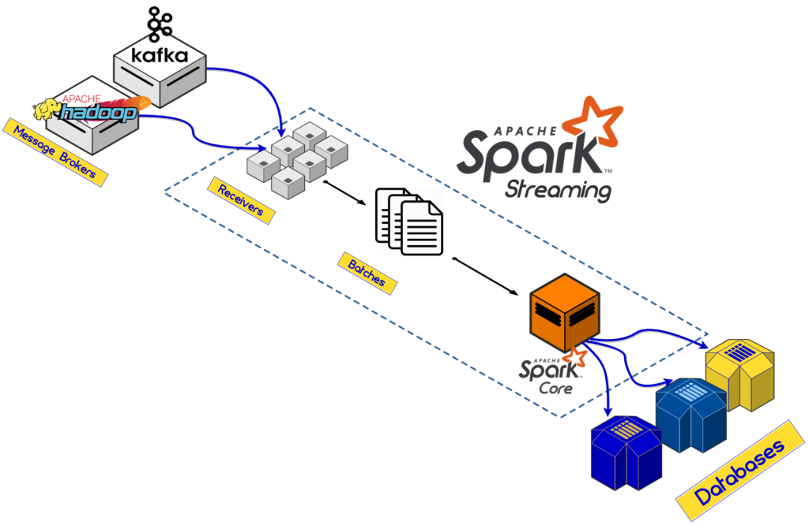

Slide 24
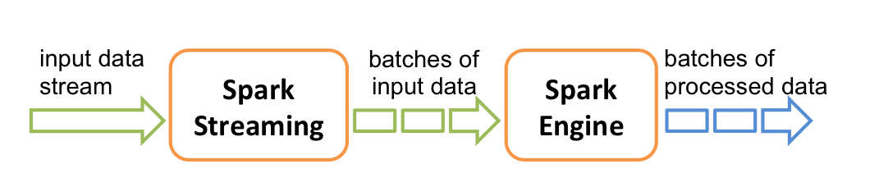
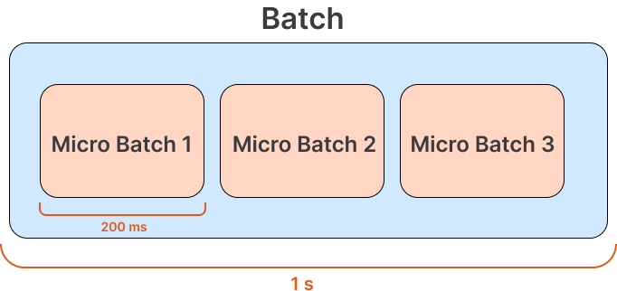
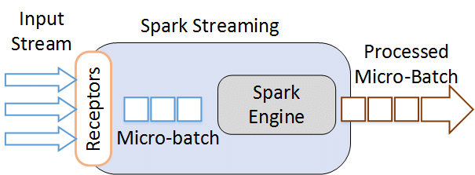
Spark Streaming Batch

Slide 25
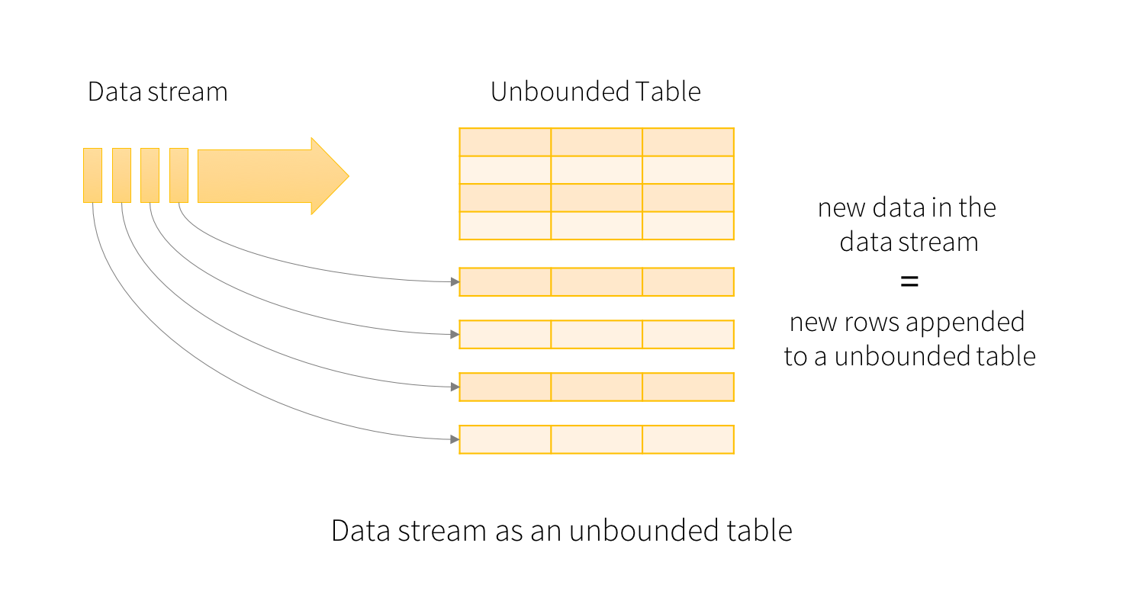
How stream works?

Slide 26
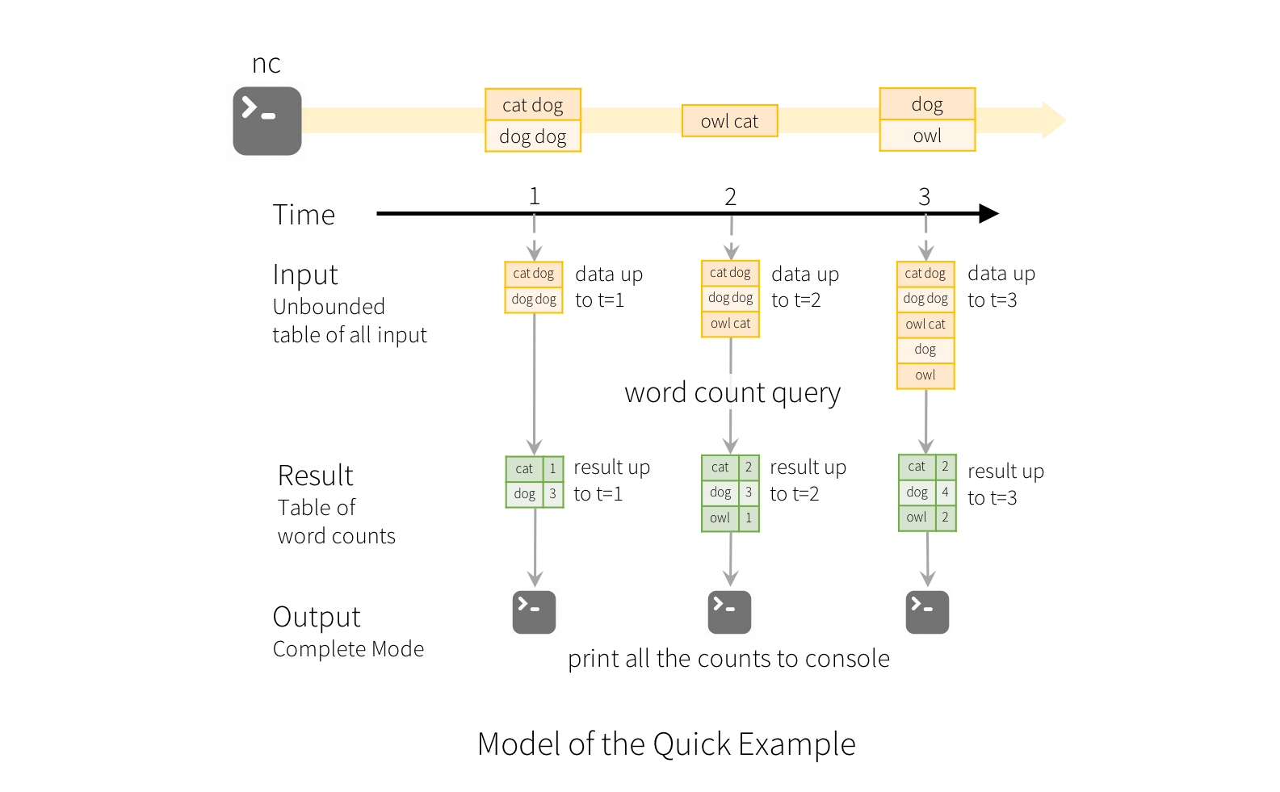
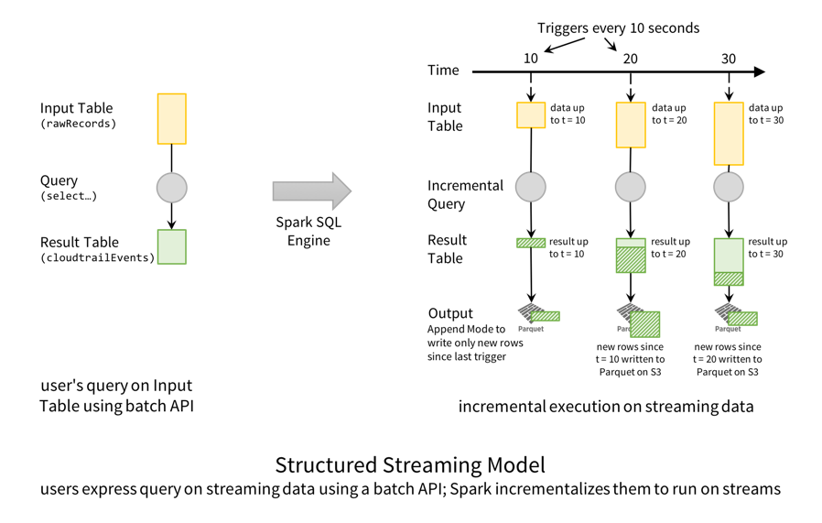
Example of work

Slide 27
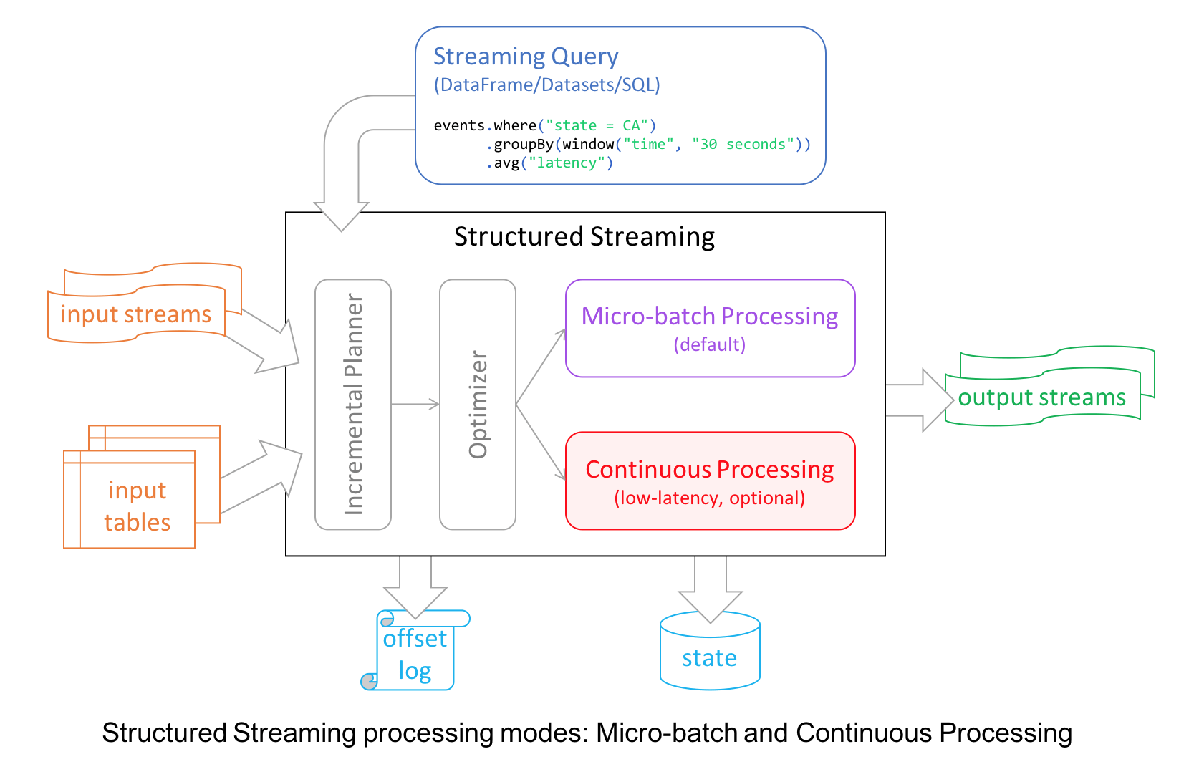

Slide 28
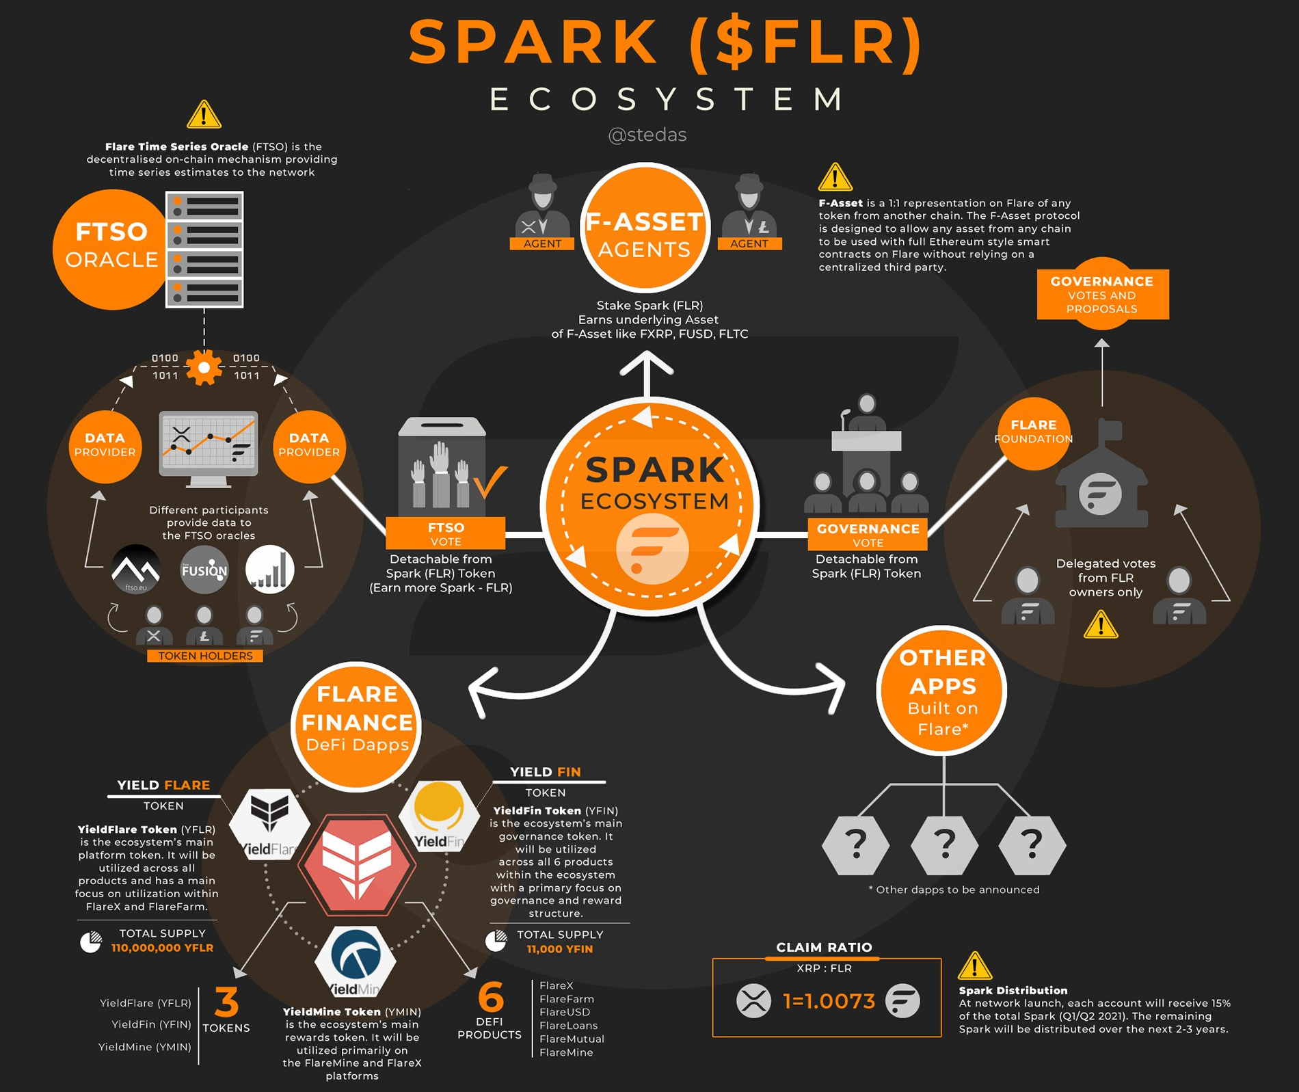
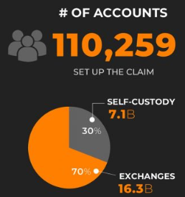
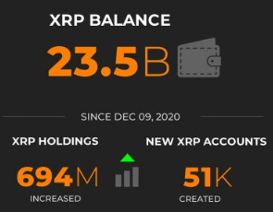

Slide 29
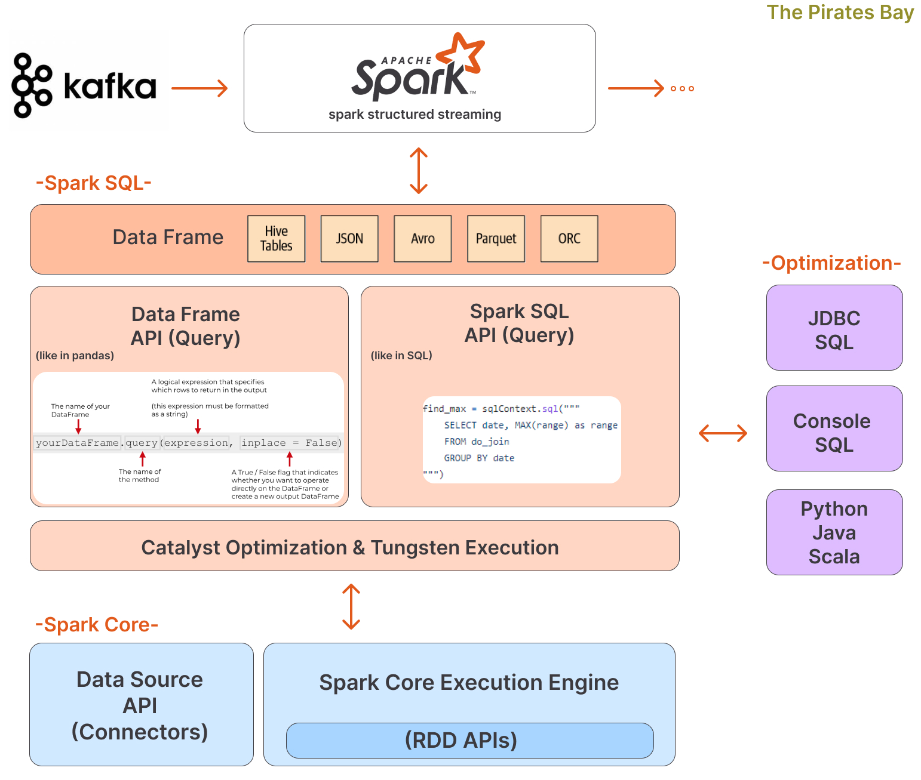
Spark SQL
Spark SQL is a Spark module for structured data processing. It provides a programming abstraction called DataFrames and can also act as a distributed SQL query engine. It enables unmodified Hadoop Hive queries to run up to 100x faster on existing deployments and data.

Slide 30
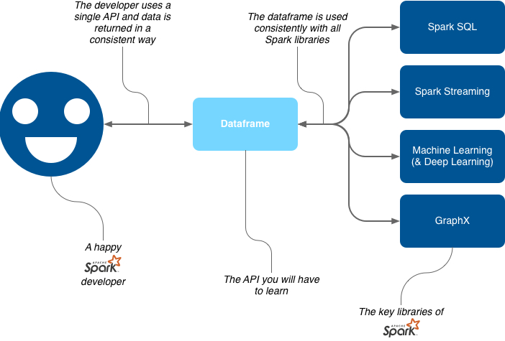
What do I need to learn from this?

Slide 31
Sample PySpark code example, word count
import sys
from pyspark import SparkContext, SparkConf
if __name__ == "__main__":
# create Spark context with necessary configuration
sc = SparkContext("local","PySpark Word Count Exmaple")
# read data from text file and split each line into words
words = sc.textFile("D:/workspace/spark/input.txt").flatMap(lambda line: line.split(" "))
# count the occurrence of each word
wordCounts = words.map(lambda word: (word, 1)).reduceByKey(lambda a,b:a +b)
# save the counts to output
wordCounts.saveAsTextFile("D:/workspace/spark/output/")

Slide 32
Sample SparkSQL code example, word count
# create a silly test dataframe from Python collections (lists)
wordsDF = sqlContext.createDataFrame([('look',), ('spark',), ('tutorial',) , ('spark',), ('look', ), ('python', )], ['word'])
wordsLengthsDF = wordsDF.select(length('word').alias('lengths')) # transformation
wordCountsDF = (words DF.groupBy('word').count())
wordCountsDF.show()

Slide 33
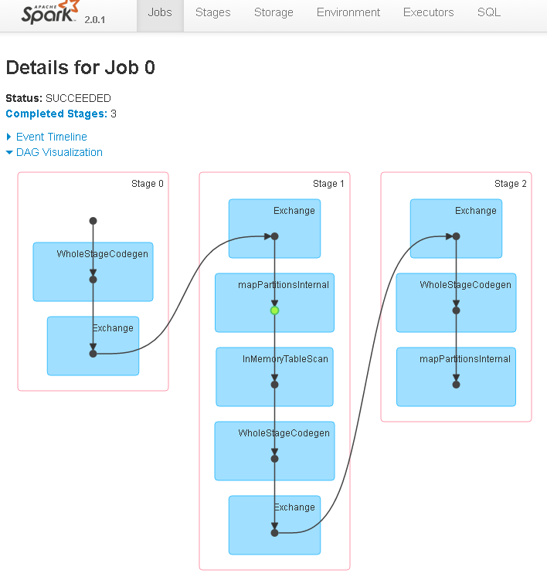
Spark UI
The web interface of a running Spark application to monitor and inspect Spark job executions in a web browser

Slide 34
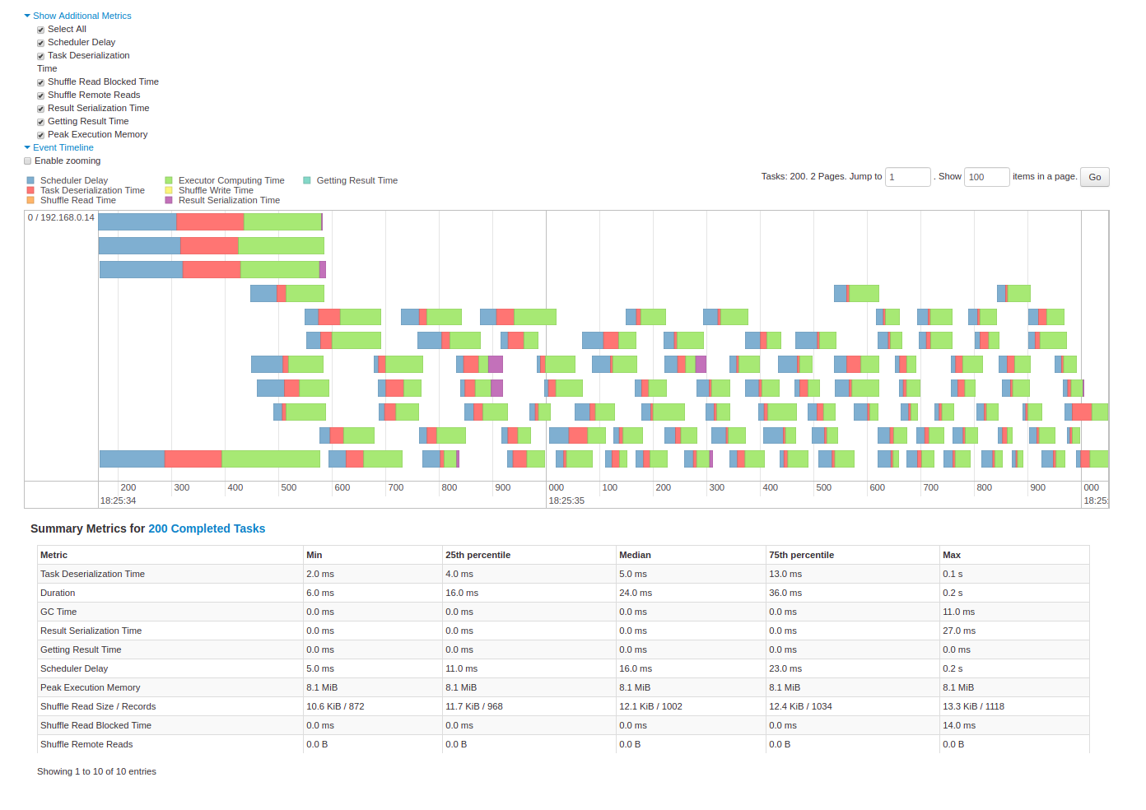

Slide 35
What we haven't talked about
Lazy Evolution
Efficiency/Memory use
Executor/Worker Models
Catalyst Optimizer
Tungsten
Driver
ClusterManager
Fault Tolerance
Dependency Types
Stages and Tasks

Slide 36
Thanks!

Slide 37
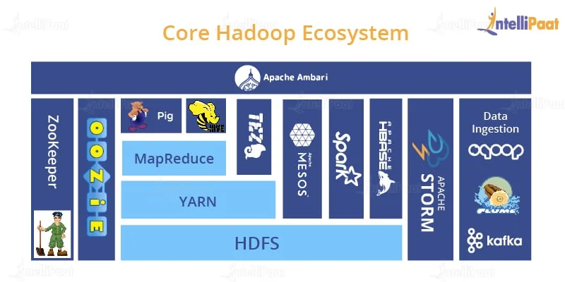

Slide 38
